Slide 1
Instruction Set Architecture, Assembly Code

Slide 2
Machine language
Machine language:
registers store collections of bits
all data and instructions must be encoded as collections of bits (binary)
bits are represented as electrical charges (more or less)
control logic and arithmetic operations are implemented as circuits, which are driven by the movement of electrical charges
so, the instructions directly manipulate the underlying hardware
The collection of all valid binary instructions is known as the machine language.

Slide 3
The Abstraction Machine
CPU
Address
Memory
Code + Data
PC
ALU
Register
Data
Stack
Condition Code
Instruction
PC- Program counter
PC point to next instruction
Condition codes- helps in taking decision such as condition and loop

Slide 4
Example of instruction set
MIPS (Microprocessor without Interlocked Pipeline Stages)
Microprocessor without Interlocked Pipeline Stages (MIPS) refers to a pioneering RISC processor architecture known for its simplicity and high performance, where the "MIPS" acronym highlights its key design choice: the hardware doesn't automatically handle data dependencies (hazards), instead leaving that optimization to the compiler to insert NOPs (No-Operations) or rearrange instructions, reducing hardware complexity and enabling faster clock speeds by avoiding hardware stalls.
Real and simple to understand
Used by Sony play station, silicon graphics, NEC (National Electrical Code)

Slide 5
MIPS Memory Organization
Bytes are nice, but most data items use larger "words"
For MIPS, a word is 32 bits or 4 bytes.
2³² bytes with byte addresses from 0 to 2³² - 1
2³⁰ words with byte addresses 0, 4, 8, ... 2³² - 4
Words are aligned, that is, each has an address that is a multiple of 4.

Slide 6
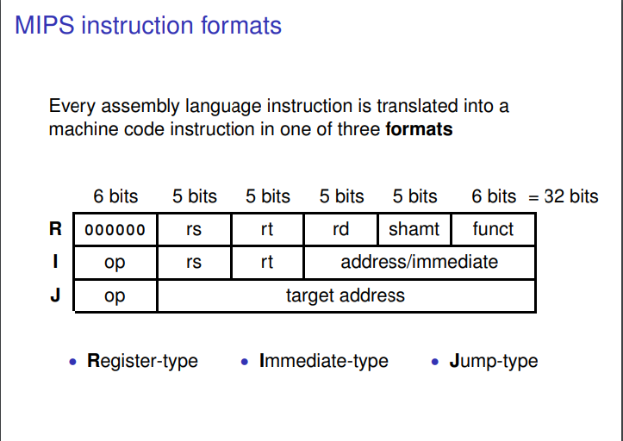

Slide 7
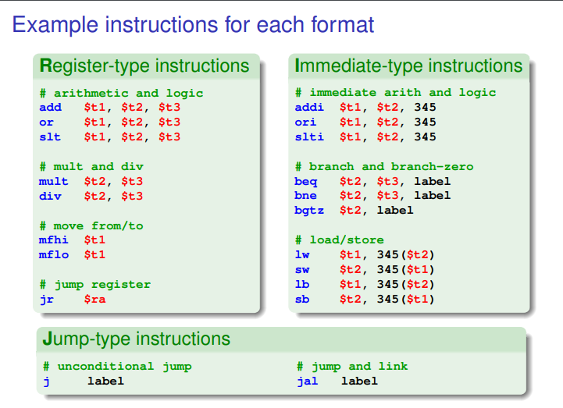
slt (Set if Less Than)
beq (Branch if Not Equal)
bne (Branch if Not Equal)
bgtz (Branch on Greater Than Zero)

Slide 8
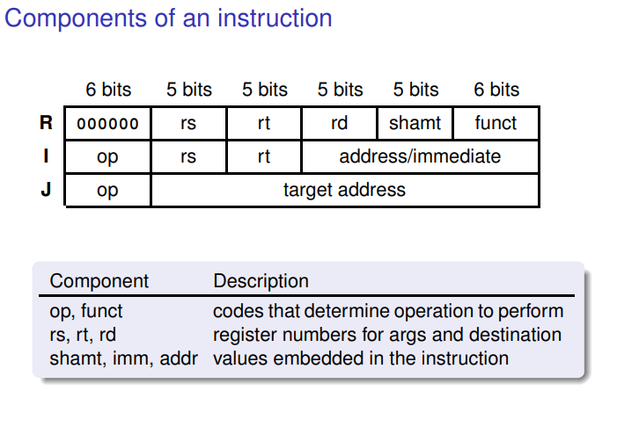

Slide 9
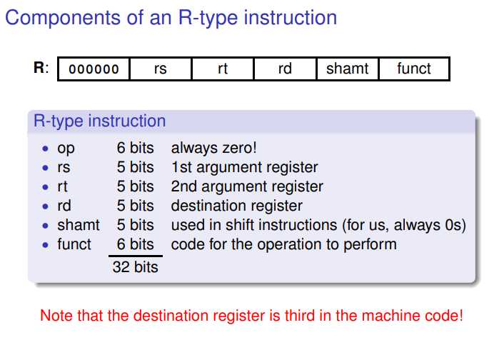
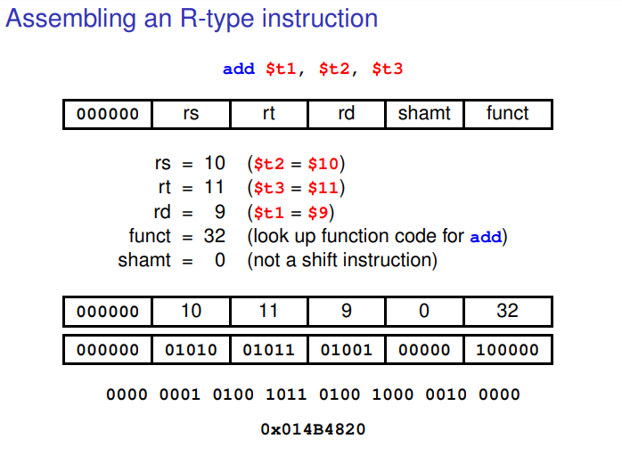
R-type Instructions

Slide 10
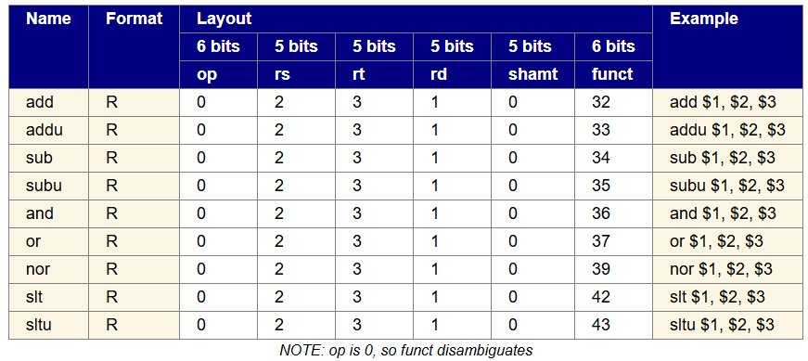
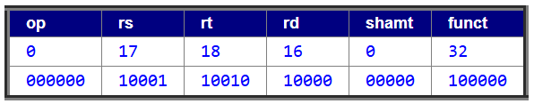
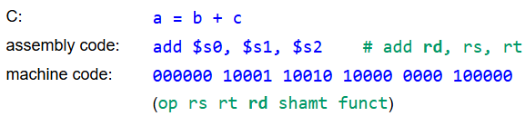
add $s0, $s1, $s2
(registers 16, 17, 18)
NOTE: Order of components in machine code is different from assembly code. Assembly code order is similar to C, destination first. Machine code has destination last.

Slide 11
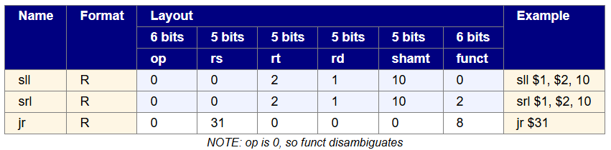
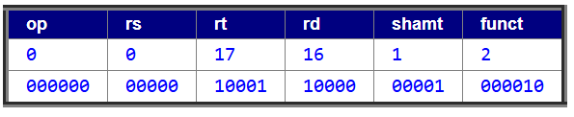
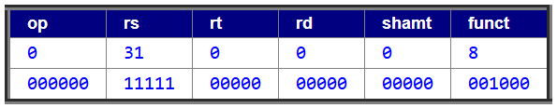
R-format Exceptions
Still have opcode 0 (all of them!), 3 registers, a shift amount, and a funct code.
srl $s0, $s1, 1
(registers 16, 17)
jr $ra
(register 31)

Slide 12
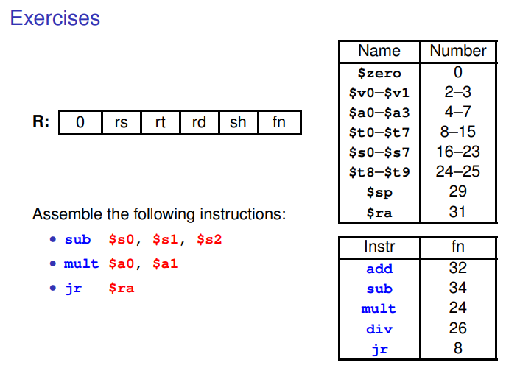

Slide 13
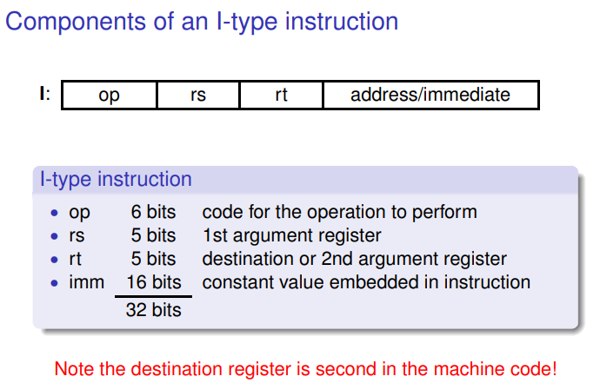
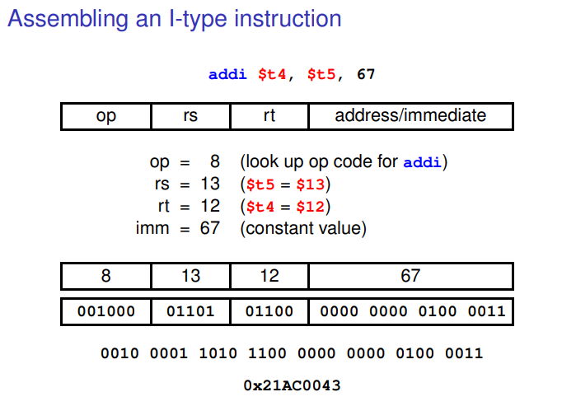
I-type Instructions

Slide 14
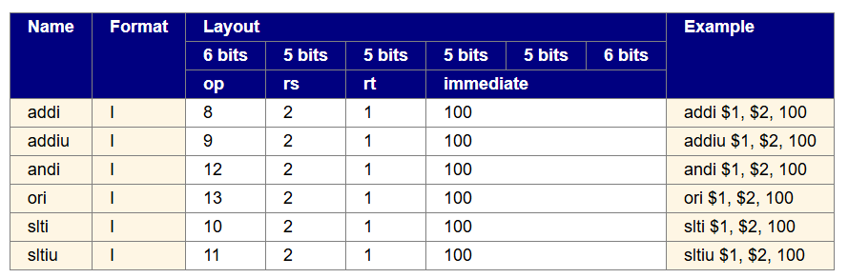
Instructions that follow typical format:
Have 2 registers and a constant value immediately present in the instruction.
rs: source register (5 bits)
rt: destination register (5 bits)
immediate value (16 bits)
NOTE: Order of components in machine code is different from assembly code. Assembly code order is similar to C, destination first. Machine code has source register, then destination.
Exceptions: beq, bne, lw, sw, lui

Slide 15
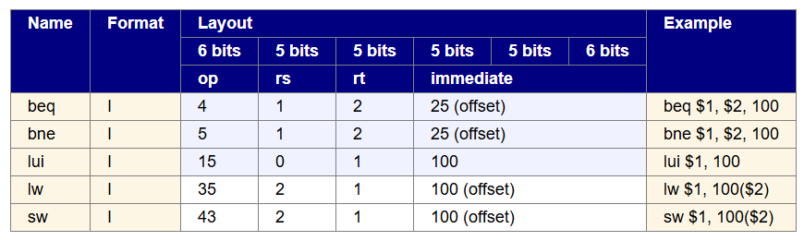
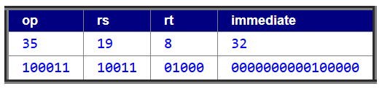
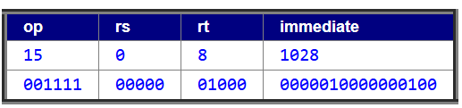
Exceptions:
beq, bne, lw, sw, lui
Still have 2 registers and a constant value immediately present in the instruction.
rs: operand or base address (5 bits)
rt: operand or data register (5 bits)
immediate: value or offset (16 bits)
lw $t0, 32($s3) (registers 8 and 19)
lui $t0, 1028 (register 8)

Slide 16
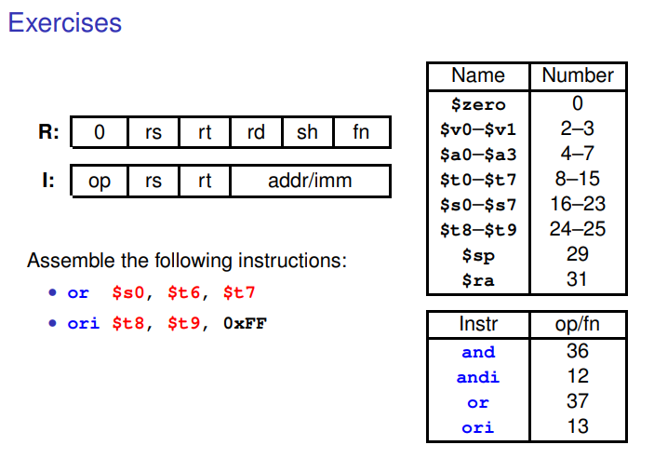

Slide 17
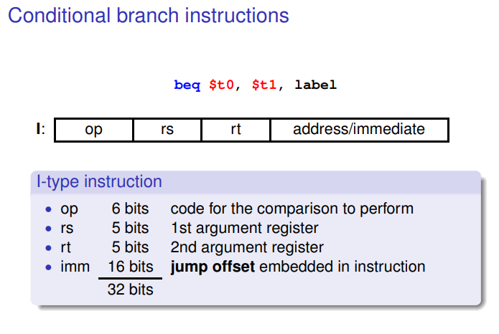
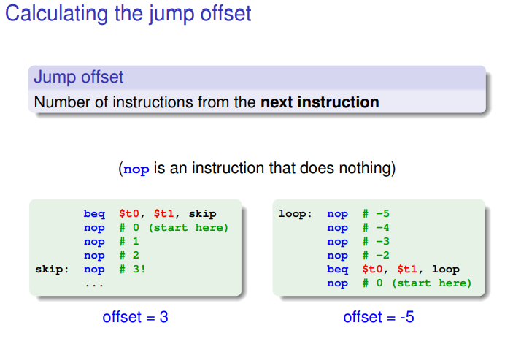

Slide 18
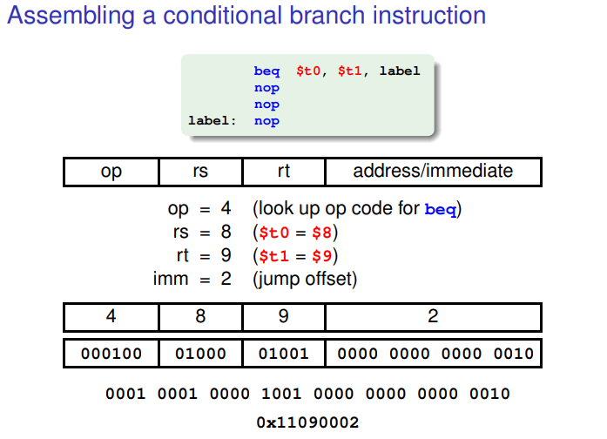

Slide 19
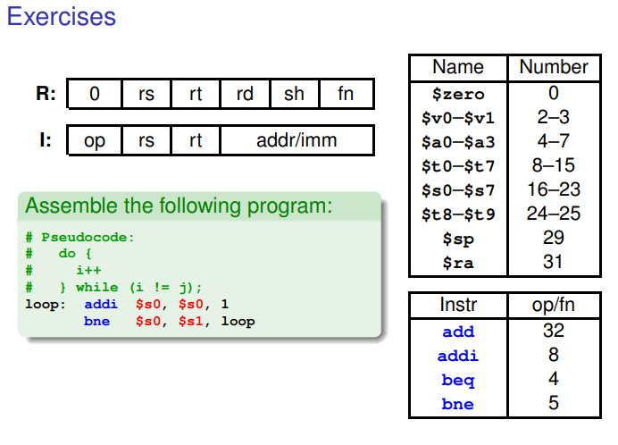

Slide 20
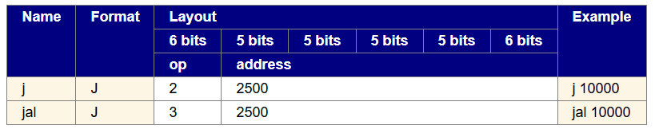
J-type Instructions
J-format Instructions:
Have an address (part of one, actually) in the instruction.
j LOOP

Slide 21
Thank you

